Slide 1

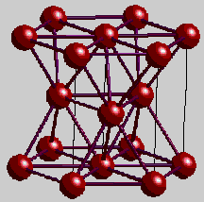
Single-Crystal Beryllium and its Potential Uses in X-ray Optics
Muhammed Sameed
Advanced Photon Source (APS)
Argonne National Laboratory
msameed@aps.anl.gov
Advisor: Ali Khounsary
Lee Teng Internship 2010
Source: www.chem.ox.ac.uk

Slide 2
Motivation
Powerful X-ray beams from synchrotron facilities such as APS are broadband
Use diffraction from crystals to monochromatize the beam
Single-crystal silicon or polycrystalline beryllium in use right now – associated problems:
Silicon crystals not as transparent to X-rays as beryllium
Regular Be has grains that scatter radiation
Solution?
Use Single-Crystal Beryllium (SCB)
But good quality beryllium monocrystals are not currently available ☹

Slide 3
Project Goals
Understand the structure of Single-Crystal Be
Properties (mechanical, thermal, optical)
Anisotropy
Outline the fabrication of beryllium crystals
Production Processes
Commercial Manufacturers
Identify potential X-ray uses of SCB
Review and analyze experimental data
Experiments at APS
Tests conducted at other locations

Slide 4
Questions?

